Slide 1
Carbon emission prediction
APAI PROJECT WORK A.Y. 2023/24
MASTER DEGREE IN ARTIFICIAL INTELIGENCE, UNIVERSITY OF BOLOGNA
FATEMEH BOZORGI
FATEMEH.BOZORGI@STUDIO.UNIBO.IT

Slide 2
outline
Introduction
Idea and Objectives of the project
Data exploration
Neural Network Architecture Overview
experimental results
Conclusion

Slide 3

introduction
Green computing, also called sustainable computing, is the process of developing and optimizing computer chips, systems, networks, and software in such a manner that can maximize efficiency by utilizing energy more efficiently and minimizing the negative environmental influence on the surrounding.
S. G. Paul et al., "A Comprehensive Review of Green Computing: Past, Present, and Future Research," in IEEE Access, vol. 11, 2023

Slide 4
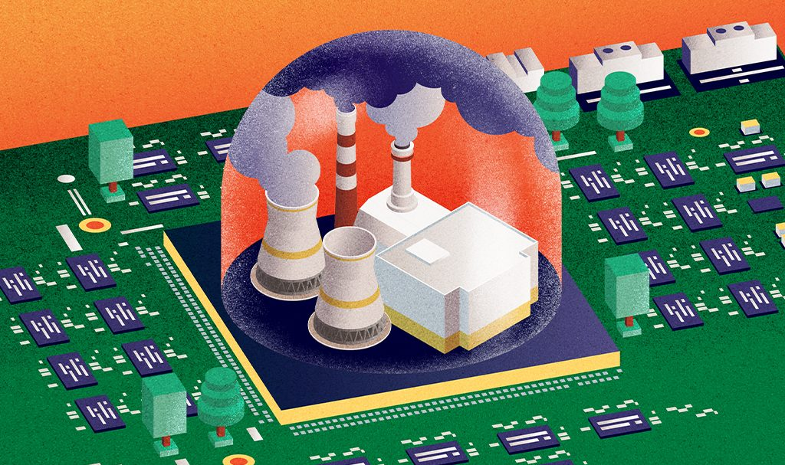
Introduction (cont.)
Computing systems impact the environment at various stages of their life cycle. This includes the production phase, where silicon is processed, and the packaging and manufacturing of hardware occur. During operation, energy consumption contributes to environmental strain, and after their useful life, these systems generate electronic waste, posing significant recycling challenges.
One of the most significant environmental impacts of large computing facilities is the emission of carbon dioxide (CO2) and other greenhouse gases into the atmosphere.

Slide 5
Comparing carbon footprint in hpc centers and other sectors
Data centers generate the same amount of carbon emissions as global airlines.(1)
Recent studies estimate that computing and communication technology sectors are responsible for 2% of global carbon emissions.(2)
Transport accounts for around one-fifth of global carbon dioxide (CO₂) emissions — 24% if we only consider CO₂ emissions from energy.
Aviation — while it often gets the most attention in discussions on action against climate change — accounts for 11.6% of transport emissions. It emits just under one billion tonnes of CO₂ each year — around 2.5% of total global emissions.(2)
(1) Khosravi, Atefeh, Saurabh Kumar Garg, and Rajkumar Buyya. "Energy and carbon-efficient placement of virtual machines in distributed cloud data centers." Euro-Par 2013 Parallel Processing: 19th International Conference, Aachen, Germany, August 26-30, 2013. Proceedings 19. Springer Berlin Heidelberg, 2013.
(2) https://ourworldindata.org/co2-emissions-from-transport

Slide 6
environmental effect of CO2
Carbon emissions contribute to global warming by trapping heat in the atmosphere, leading to climate change and its associated impacts such as extreme weather, sea level rise, and disruptions to ecosystems.
Due to the serious problems that carbon emission has to the environment, we have to reduce the carbon footprint in all the involved sectors included data centers.
The science is clear: sustainable development and climate action are inseparable (nature.com)

Slide 7
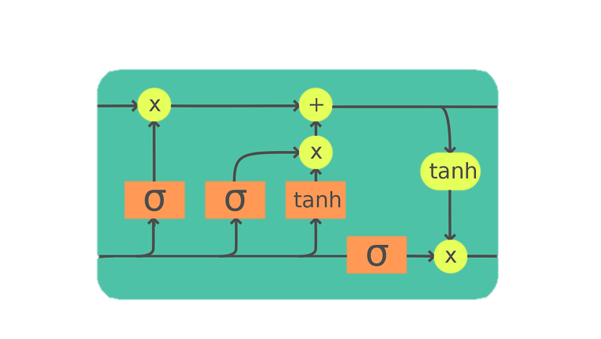
Idea
This project aims to create a carbon intensity (CI) predictor for HPC systems. When an HPC job is received, the system will use this predictor to decide whether to run the job immediately or delay it to reduce carbon emissions.
The architecture that is used as predictor is LSTM (Long Short-Term Memory) and it is implemented in pytorch.
LSTM networks are effective in modeling time series data by capturing long-term dependencies, overcoming the vanishing gradient problem in traditional RNNs (Hochreiter & Schmidhuber, 1997).
Hochreiter, S., & Schmidhuber, J. (1997). Long short-term memory. Neural Computation, 9(8), 1735-1780.

Slide 8
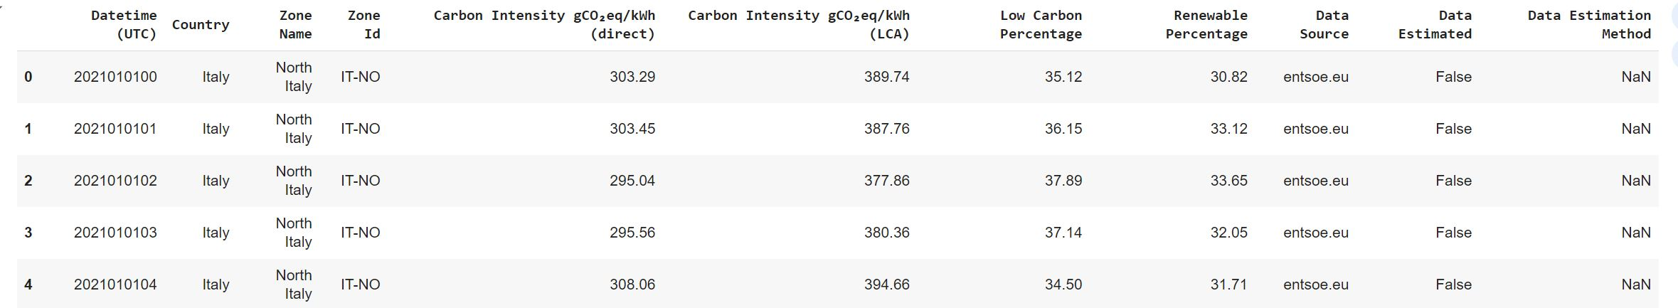
data
There is a dataset that was created as follows: Between 2021 and 2023, data was continuously recorded every hour at a data center. This ongoing process generated a comprehensive dataset, as illustrated in the accompanying image.
For this project we consider only one column of “Carbon Intensity gCO₂eq/kWh (direct)”.

Slide 9
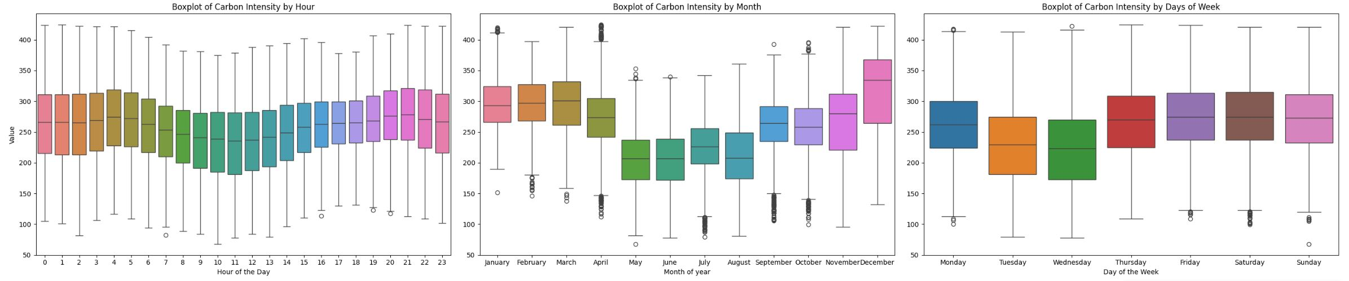
Data exploration
After some data processing, we found some patterns in carbon emission during these three years.
In some particular hours of day like at 11 or on Thursday and Wednesday or on May and June the carbon emission are lower than other times.
So the environmental cost of power consumption in different periods is different, by predicting this cost we can optimize it.

Slide 10
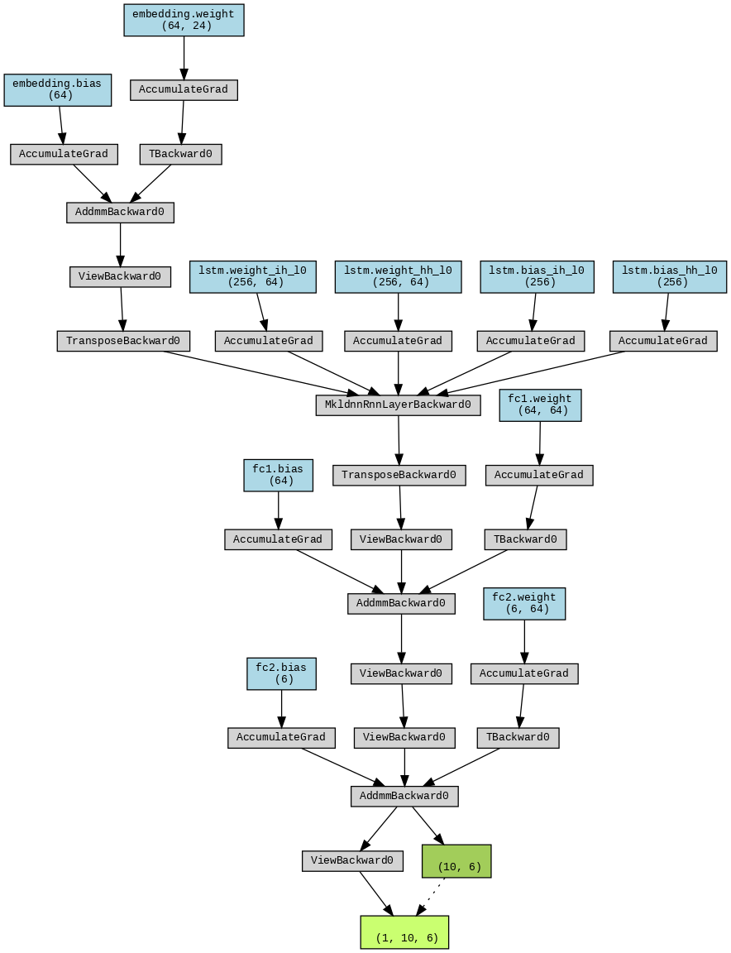
Neural Network Architecture
This neural network consists of an embedding layer that first transforms the input into a dense representation.
Following this, a LSTM layer captures temporal dependencies in both forward and reverse directions.
The network then uses two fully connected layers to further process the information and produce the final output.
Additionally, it employs batch normalization to ensure stable and efficient training. The model is flexible, allowing for adjustments in layer sizes and the use of dropout for regularization.

Slide 11
experimental results
For the architecture we consider three different set up:
First one is to make the data set in a way that the model receive the 24 hours as input of model and then predict the next 6 hours
The other approach is the model predict the next month based on the last month.
The last approach is the model take the last year data and predict the next month

Slide 12
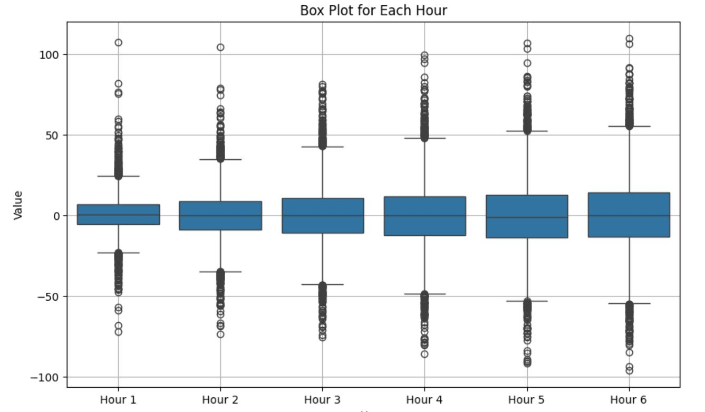
First experiment
As it can be expected the model predicts the first hour better than the later ones and here is the errors for each hour calculated on the test set:

Slide 13
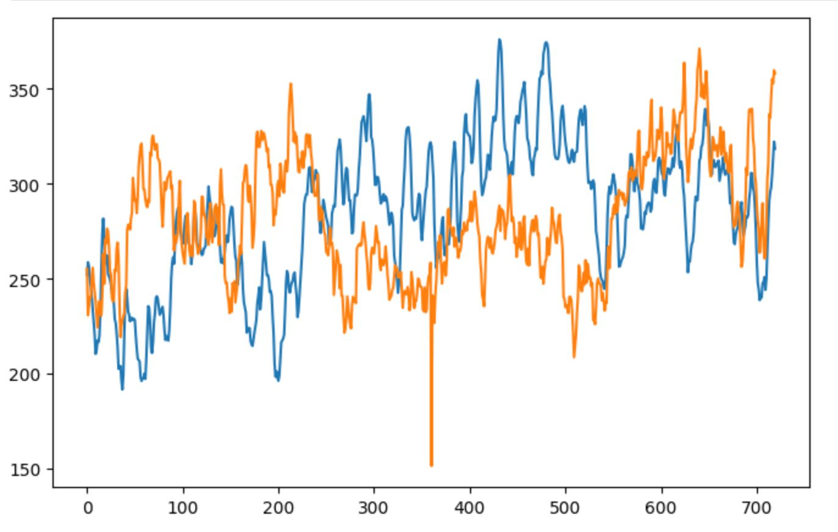
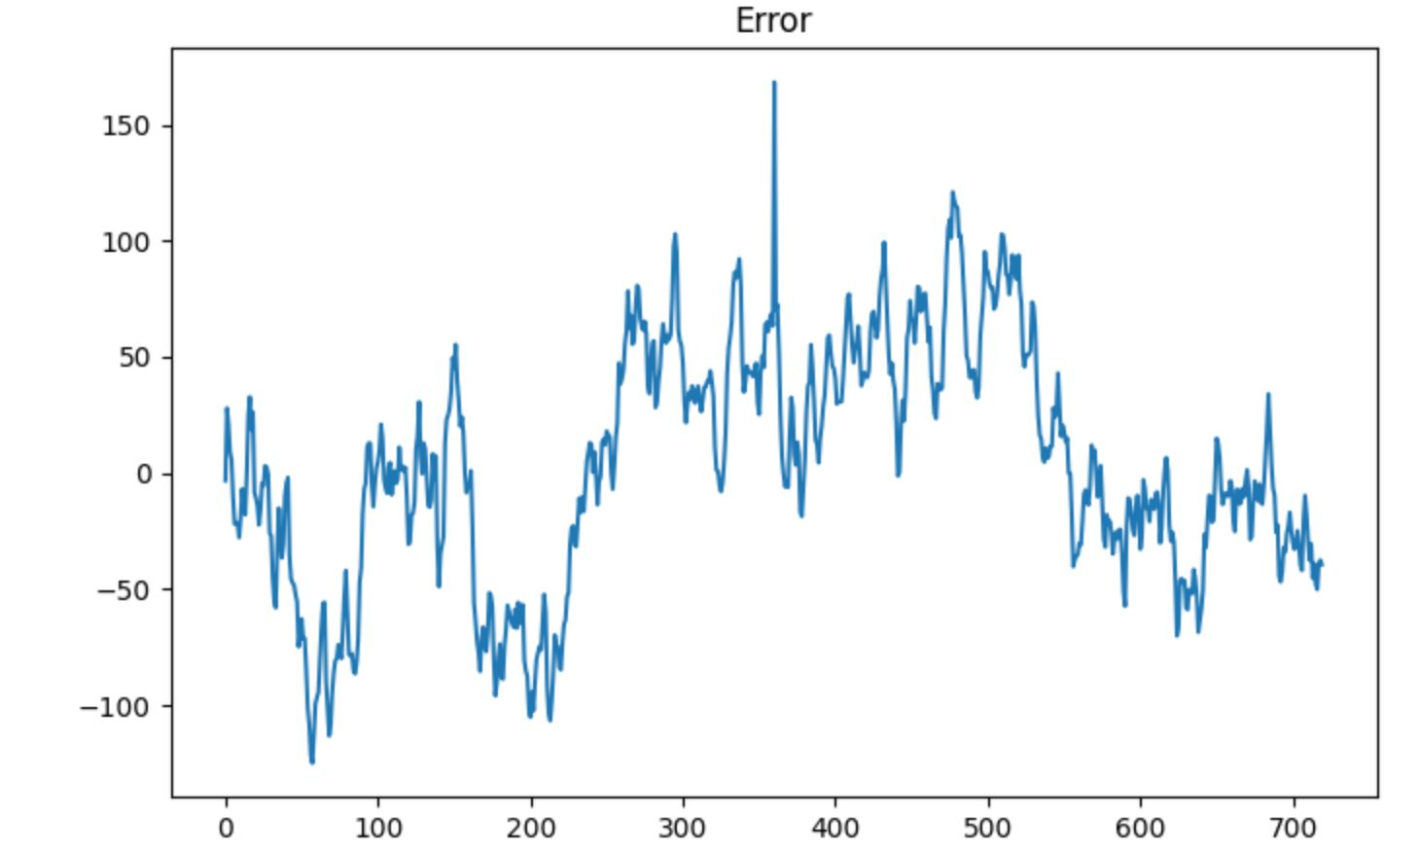
second experiment
The second approach that take a month and predict the next month is less accurate than the previous model and as you can see the plot below show the real values(blue line) and predicted one(orange) for a month in test set.

Slide 14
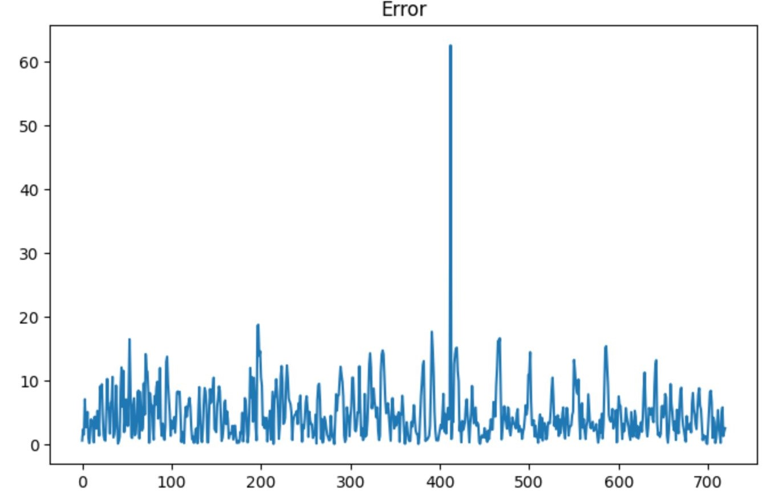
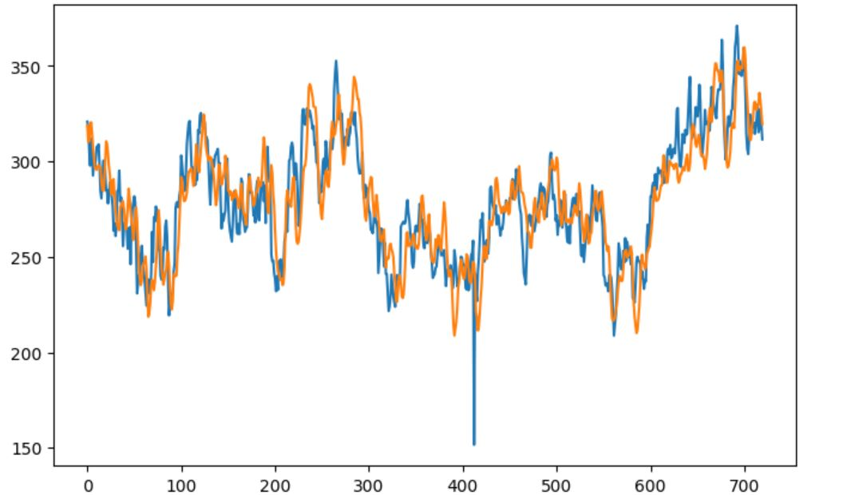
Third experiment
The third approach that take a year and predict the next month is more accurate than the previous models and as you can see the plot below show the real values(blue line) and predicted one(orange) for a month in test set.

Slide 15
conclusion
Developed a neural network model using LSTM to predict carbon intensity in HPC systems.
Achieved the best prediction accuracy by using a year’s data to predict the following month.
Demonstrated potential for optimizing HPC job scheduling to reduce carbon emissions.

Slide 16
Thank you

